Slide 1

COMPANY
PROFILE
2025 RIKKEISOFT CORP.
www.rikkeisoft.com

Slide 2

About Rikkeisoft
CONTENTS
Engineering Services
Engineering Capabilities
Client Network
Notes:
(Key Topics should align in the center with the Section Title)

Slide 3
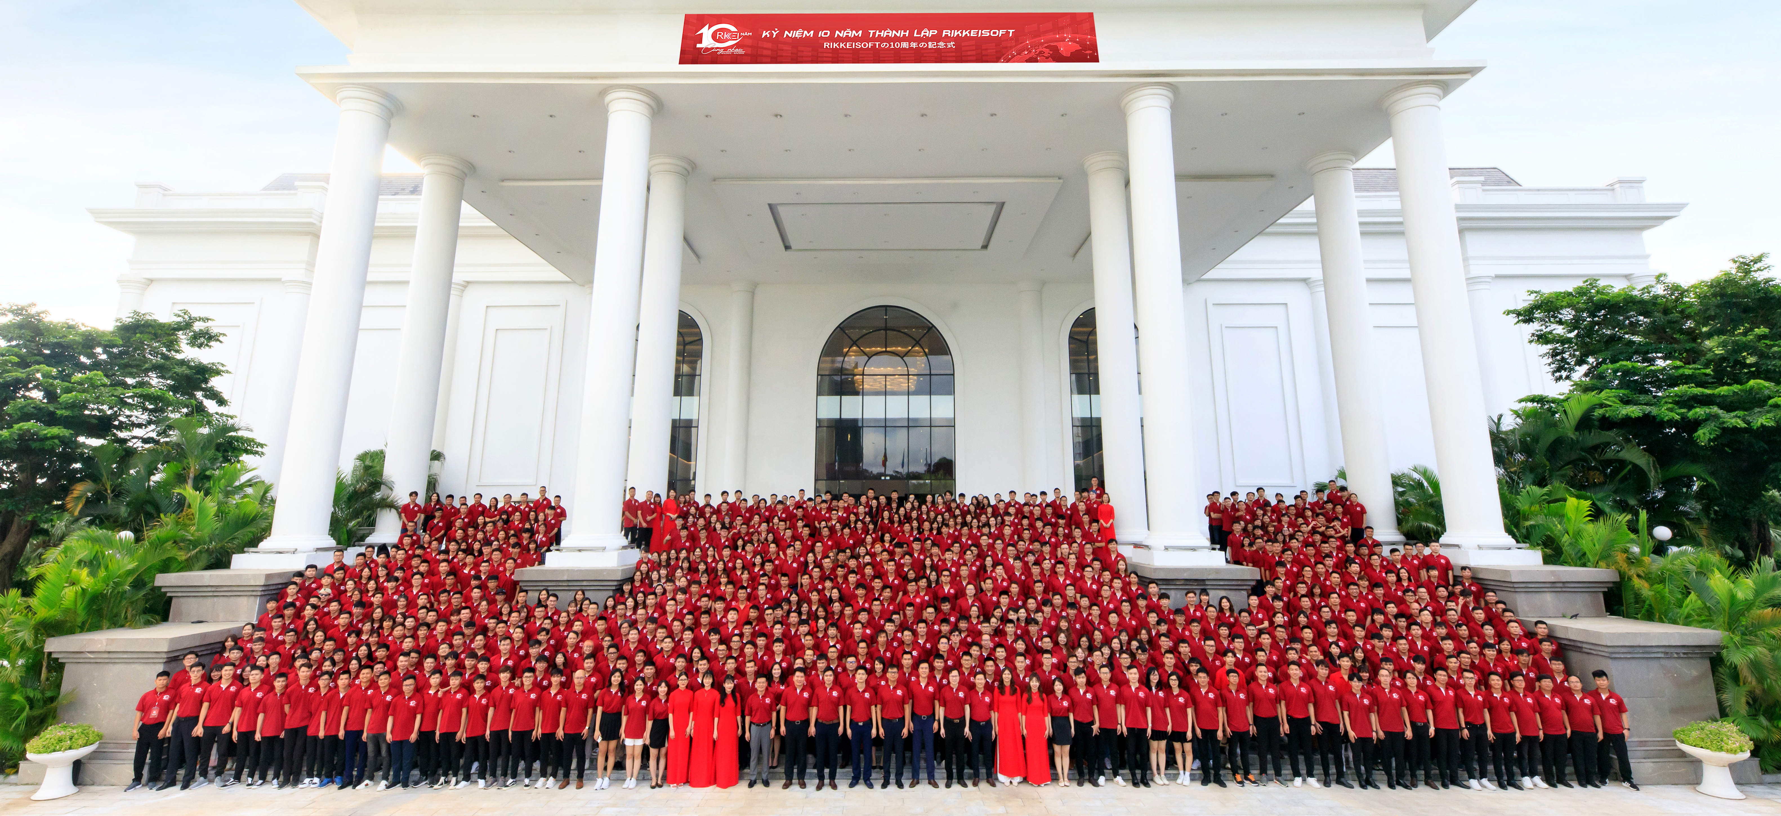
01 – About Rikkeisoft
Rikkeisoft
A Leading Technology Company
Rikkeisoft is a dynamic and rapidly growing software company at the forefront of innovation. With a passion for cutting-edge technology and a team of young, creative minds, we are dedicated to transforming ideas into impactful solutions.
Our commitment to excellence, coupled with a fresh perspective, allows us to deliver software that not only meets but exceeds expectations. Join us on our journey as we shape the future through innovative software solutions.

Slide 4
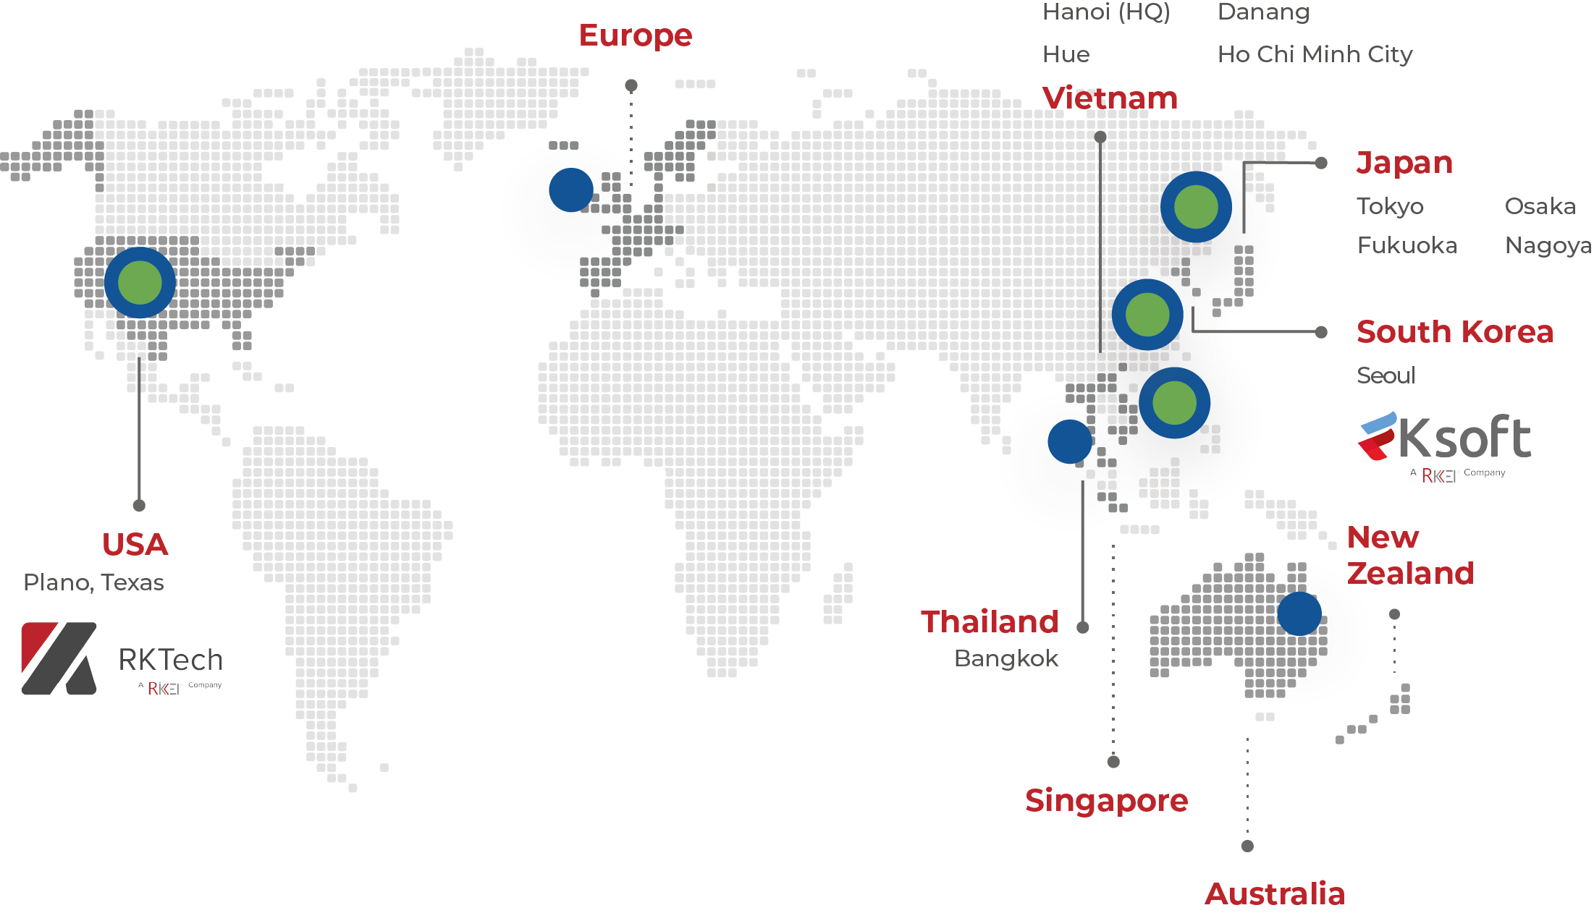






01 – About Rikkeisoft
Global Presence
Our Growth
Presence in 3 Continents with Hundreds of Clients Worldwide
Employees
2200+
1800
1109
1250
600
420
139
217
49
91
12
2012
2013
2014
2015
2016
2017
2018
2019
2020
2023
2024
Certification
97%
95%
Customer Retention Rate
Customer Satisfaction Rate
Delivery centers
2,200+
1,000+
Clients
Employees
Projects
No. 01
80%
Private tech company in Vietnam
Growth through referral

Slide 5

01 – About Rikkeisoft
History
2012
2014
2016
10.000
Founded Rikkeisoft
Honored Top 30 Vietnamese ICT* companies
Obtained ISO 9001:2015 & ISO/IEC 27001/2013
Reached 1 million USD revenue
Established Rikkei Japan and Danang branch
2019
2020
2021
Reached 1,000 total employees
Established Rikkei AI and Ho Chi Minh City branch
Honored Top 10 Vietnamese ICT companies
New Osaka (Japan) branch
Best Venture 100 Japan Award
Established Rikkei Capital
2022
2023
2024
Won Silver Award at the IT World Awards
Established Rikkei Digital & Rikkei Academy
Established New Hue City branch
Established New Fukuoka City branch
Established RKTech (U.S. Subsidiary)
Obtained CMMI Level 3
Established Rikkei Thailand
Won Stevie Awards 2023 - Bronze Winner
Won Top 5 Best Enterprise Software Development Companies by TechTimes
Won Top 10 Most Promising IT Services Companies by CIOReview
Entered strategic partnership with Sumitomo
Established RKSoft (South Korea Subsidiary)
Reached 2,000 employees
Won Stevie Awards 2024 - Bronze Winner
*ICT: Information & Communications Technology

Slide 6







01 – About Rikkeisoft
Awards and Certifications
Certification
Leadership Recognition
Entrepreneur of the Year awarded to Chairman Ta Son Tung by the Prime Minister of Vietnam
CMMI Level 3
ISO 9001:2015
ISO/IEC 27001/2013
CSM Certificate
Company Recognition
Forbes 30 under 30
Given to Chairman Ta Son Tung
IT World Award 2022 Silver Winner
Stevie Awards 2023
Bronze Winner
Top 10 Information & Communications Companies in Vietnam (2015-2022)
Top 10 Most Promising IT Services Companies in 2023
Forbes 30 under 30
Given to CEO Rikkei Japan
Bui Quang Huy
SEVP of Rikkeisoft Becomes a Member of Forbes Technology Council 2023
Best Venture 100 2020
Top IT Consultants Vietnam 2022

Slide 7
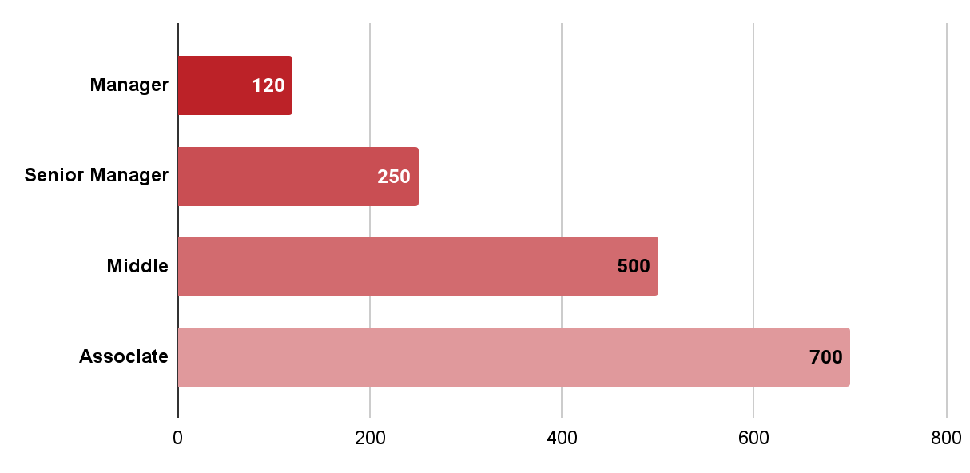





01 – About Rikkeisoft
Human Resources Team
Human Resources Scale
Levels
2,200+
As of October, 2024
Human Resources Qualification
6%
94%
Doctor of Philosophy & Master’s Degree
Bachelor’s Degree & Engineer

Slide 8
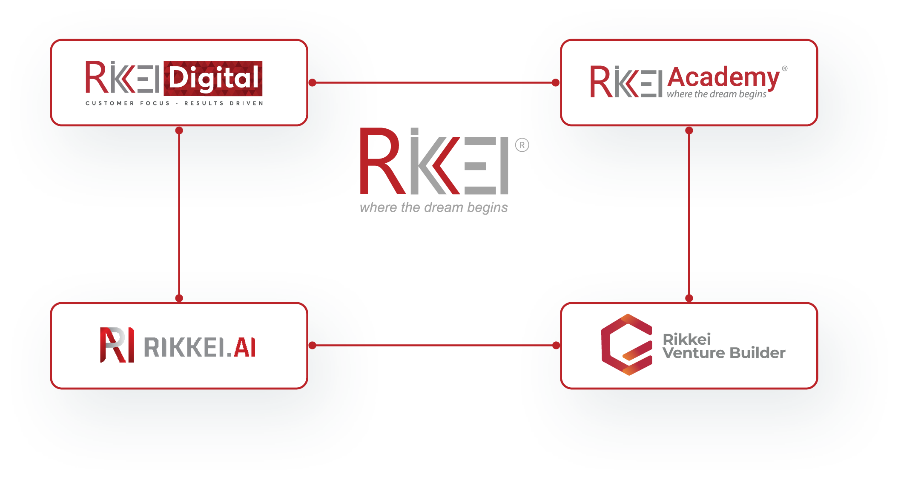






01 – About Rikkeisoft
Technology Ecosystem
Comprehensive digital transformation solutions for customers of all sizes
Innovative training center
for IT talent
Leveraging Diversified Business Units
Cutting-edge high-tech solutions to revolutionize
the way businesses work
Incubator for
disruptive startups
Partners

Slide 9



Engineering
Services
Overview
IT
Digital Solutions

Slide 10








02 – Engineering Services
Overview
Rikkeisoft provides software engineering services and enterprise application solutions in multiple industries. With over 10 years of experience in information technology, Rikkeisoft is committed to service quality, providing flexible working models tailored to customer needs.
IT SERVICES
DIGITAL SOLUTIONS
WORKING MODELS
Enterprise Software Development
Mobile App Development
Managed Services
Quality Assurance
System Migration
Cloud
Artificial Intelligence
Blockchain
Data Analytics
Low-code Service
Salesforce
SAP
Project-Based
Offshore Development Center
INDUSTRIES
Retail & eCommerce
Media & Entertainment
Finance
Manufacturing
Logistics
Transportation
Automotive
Healthcare

Slide 11

02 – Engineering Services
IT Services
From enhancing operational efficiency to forging innovative sales channels, we specialize in crafting tailor-made software solutions that effectively address business bottlenecks, ensuring customer’s enterprise remains resilient through every twist and turn.
Enterprise Software Development
Our Services
Digital Transformation Consulting
Mobile Development
Software and System Development
Software Maintenance and Upgrade
Software Testing
Mobile App Development
Managed Service
Quality Assurance
System Migration

Slide 12

02 – Engineering Services
IT Services
With in-depth knowledge of various mobile app platforms & programming languages, we provide development services on web apps, native apps, hybrid apps, and tailor-made solutions according to customer needs.
Enterprise Software Development
Our Services
Mobile App Development Consulting
Android App Development
iOS App Development
Cross-platform App Development
Mobile App Development
Managed Service
Quality Assurance
System Migration

Slide 13

02 – Engineering Services
IT Services
Delivering comprehensive administration service packages backed by round-the-clock support for all customer inquiries, we enable the customers to concentrate on growth and mitigate potential management risks effectively.
Enterprise Software Development
Our Services
Server Monitoring
Network Monitoring
Cloud Management
Managed Security
Managed DevOps
IT Infrastructure Administration
Mobile App Development
Managed Service
Quality Assurance
System Migration

Slide 14
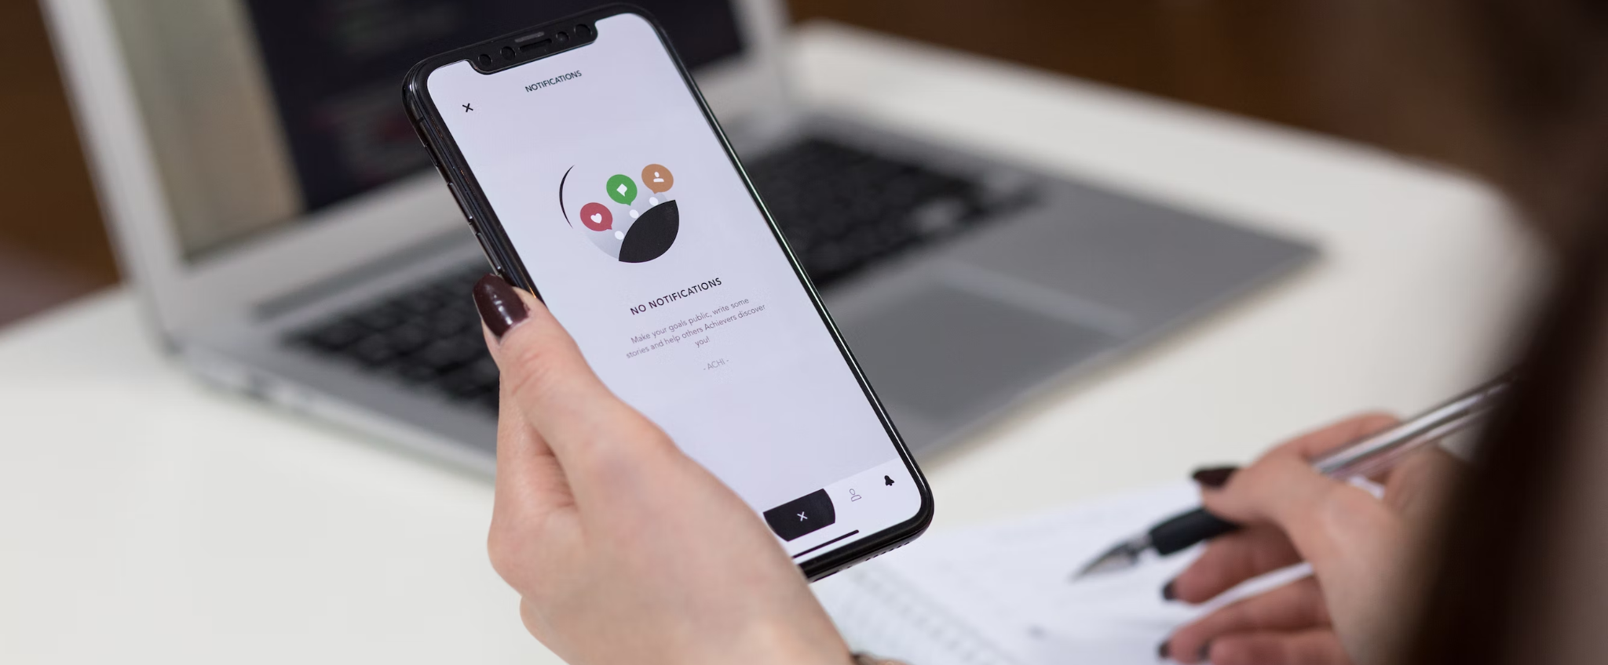
02 – Engineering Services
IT Services
Our team of ISTQB-qualified quality engineers excels both individually and collaboratively, readily scaling to accommodate project size variations efficiently.
Enterprise Software Development
Our Services
Manual Testing
Automated Testing
Mobile App Development
Managed Service
Quality Assurance
System Migration

Slide 15

02 – Engineering Services
IT Services
Enterprises are encouraged to transition from their legacy systems to embrace cutting-edge technologies, leading to heightened efficiency, enhanced cost optimization, and improved risk management.
Our comprehensive solutions encompass the entirety of the migration process, guaranteeing a seamless transition from inception to completion. This encompasses planning, installation, verification, customization, testing, data migration, and ongoing support.
Enterprise Software Development
Mobile App Development
Managed Service
Our Services
Legacy System Migration
Cloud Migration
Software Version Migration
Quality Assurance
System Migration

Slide 16


02 – Engineering Services
Digital Solutions
Cloud Computing
Rikkeisoft facilitates the seamless integration of cloud computing technology for clients, enabling the migration of services such as storage, databases, development, and testing to the online realm, thereby eliminating the need for physical server maintenance.
Amazon Web Service
Technologies
Microsoft Azure
Salesforce
Cloud Migration
Cloud Software Development
Cloud Monitoring & Optimization
Cloud services
Data Backup & Migration
DevOps
Complete Infrastructure Solution

Slide 17


02 – Engineering Services
Digital Solutions
Artificial Intelligence (AI)
In 2019, Rikkeisoft established Rikkei AI, a convergence of preeminent AI experts in Vietnam. Rikkei AI is dedicated to aiding businesses and enterprises in tackling intricate challenges through advanced technological solutions. Our array of AI applications serves to enhance company productivity and streamline costs effectively.
Image Recognition
Speech Recognition
Our Expertise
Data Mining
Natural Language Processing (NLP)

Slide 18


02 – Engineering Services
Digital Solutions
Blockchain
Utilizing blockchain technology, Rikkeisoft pioneers the creation of high-quality projects that garner national and international recognition for their remarkable applicability, transparency, and security.
Decentralized Finance (DeFi)
NFT Games
Our Expertise
NFT Marketplace
Blockchain Wallet
dApps Development

Slide 19


02 – Engineering Services
Digital Solutions
Data Analytics
Rikkeisoft's data analytics systems offer proficient data storage, management, and analysis capabilities, empowering clients to make essential decisions with heightened efficiency.
Our Expertise
Data Warehousing

Slide 20


02 – Engineering Services
Digital Solutions
Low-code Services
Utilizing low-code development platforms empowers Rikkeisoft to deliver exceptional software products to clients swiftly and at budget-friendly rates.
Microsoft Power Apps
Kony
Our Expertise
Outsystems
Salesforce Lightning

Slide 21


02 – Engineering Services
Digital Solutions
Salesforce
We tailor Salesforce products to align with the distinctive sales, marketing, and service needs of each business, all geared towards enhancing revenue generation and sales efficiency.
Sales Cloud
Service Cloud
Our Expertise
Lightning Platform
Marketing Cloud

Slide 22


02 – Engineering Services
Digital Solutions
SAP
We collaborate with enterprises to enhance SAP functionalities, addressing their specific requirements and unlocking the complete potential of their ERP system.
SAP Customization & Integration
Our Expertise
SAP Maintenance
& Managed Service

Slide 23

Engineering
Capabilities
Programming Language
Frameworks & Tools
Technology Stack
Working Model
Engagement Model

Slide 24







































03 – Engineering Capabilities
Versatile Technology Foundation
Native, PWA, and hybrid apps
Major enhancement & replacement implementation
Product development
Major enhancement & replacement implementation
Mobility
Application Development
DevOps
&
DataOps
DevOps, DataOps, CI/CD
Continuous Testing (CT)
Infrastructure as Code (IaC)
Monitoring & Logging
Rikkeisoft
Cloud, Data Analytics, AI/ML
Cloud Migration and Application Modernization
Data Engineering
Modernization &
Migration
Verification
&
Automated Validation
Functional Validation
Performance Testing
Regression Testing
Security testing
Smart Home
&
Remoted Assistance
&
IoT
Edge Computing
Wi-Fi, Zigbee, Z-Wave
Matter, NFC, UWB

Slide 25
























03 – Engineering Capabilities
Our Technology Stack
Programming languages
PHP, Java, .NET, ReactJS, Python, Angular J, HTML, CSS, Node.js, Ruby on Rails, C/C++, Golang, Cobol.
Cloud
AWS
Azure
Frameworks & Tools
Spring, Spring boot, Bootstrap, Hibernate TE, Logback/log4j2, ASP.NET, Lavarel
Database
Oracle
MySQLs
SQL Server
Mobile App
Android, iOS, Java, Swift, Objective-C, Flutter, React Native, Kotlin, Dart
ERP
Salesforce
SAP
Odoo

Slide 26
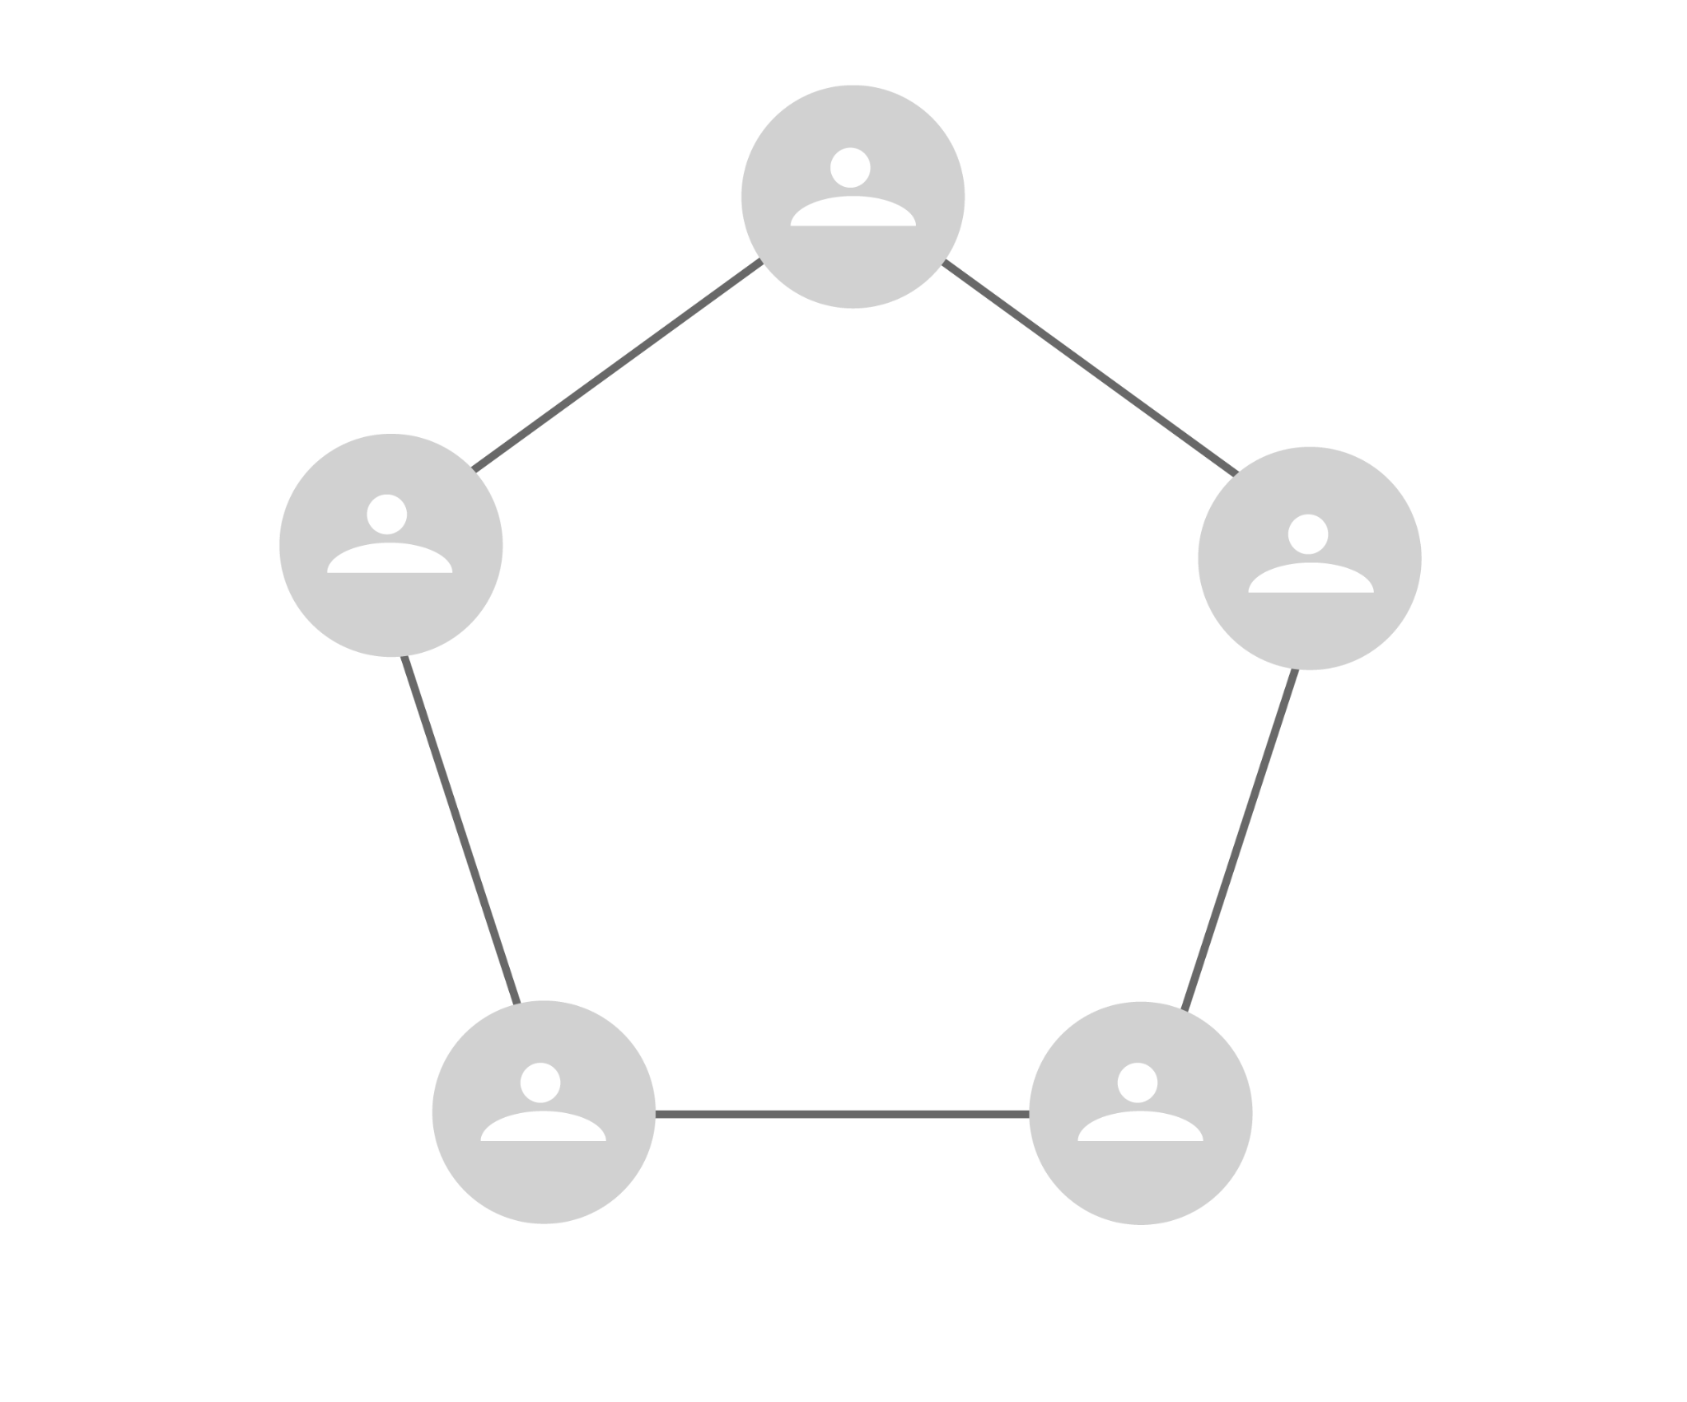
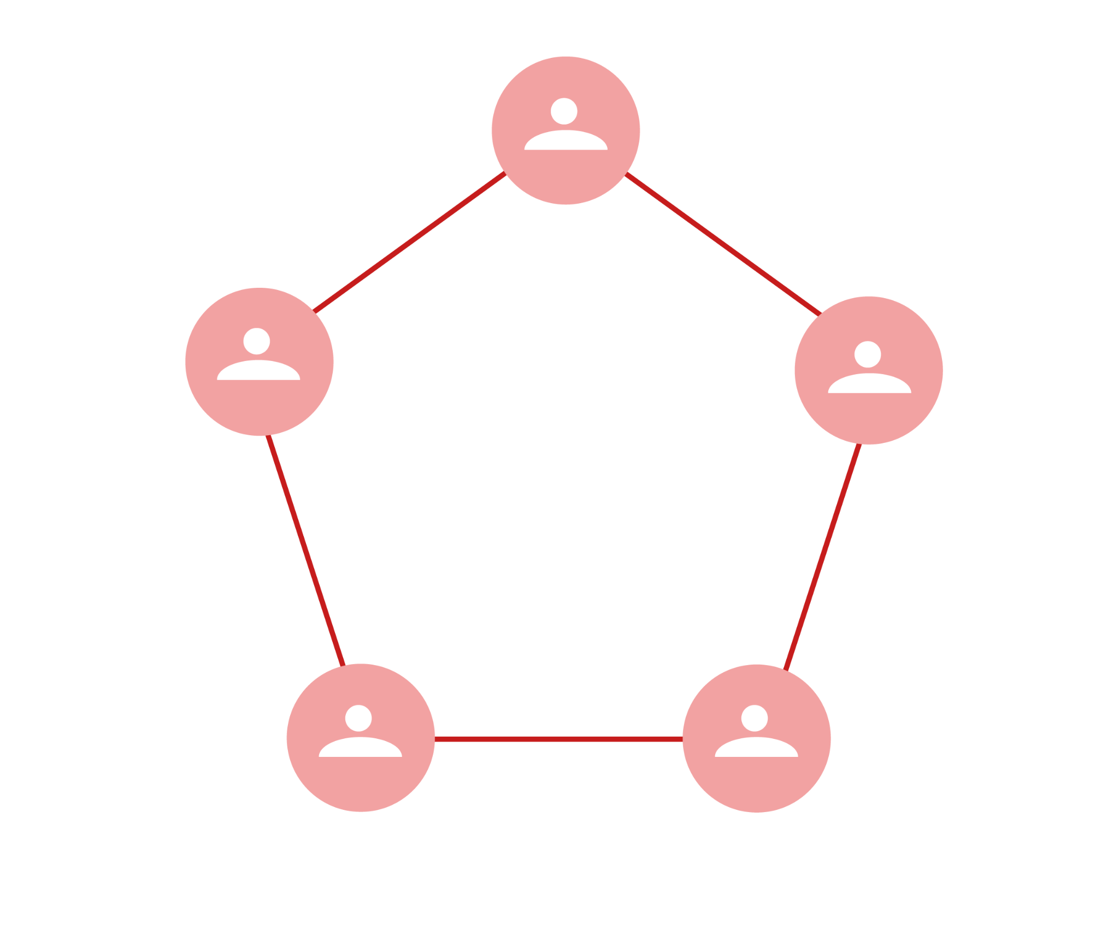
03 – Engineering Capabilities
Working Model
Project-Based
Offshore Development Center
Provide delivery team to work on projects
Ideal for short-term and small-sized projects with well-defined requirements and a fixed scope.
Provide dedicated resources to work on wide range projects
Ideal for long-term or large projects
Focus on scalability and flexibility
Team A
Project A
Team A
Project A
Project B
Team B
Project B
Team B
Project C

Slide 27

03 – Engineering Capabilities
Engagement Model
Preparation
Gather Information
Plan
Implement & Develop
QA & Validation
Launch & Maintain
01
02
03
04
05
06
Initial discussions take place between the involved parties, followed by the signing of a Non-Disclosure Agreement.
Define the development objectives, perform comprehensive business analysis, and conduct thorough market research to establish a solid foundation for the subsequent stages of the process.
Present the optimal strategic solution tailored to clients' needs based on the collected information. The master plan is then segmented into sections including design, content, programming, and individualized plans for each team.
Our team of experts executes the plan with a steadfast commitment to consistent communication, regularly updating client reports along the way.
Conduct a comprehensive assessment of both functions and designs within a controlled staging environment, guaranteeing an outcome that is devoid of any bugs or issues.
Deliver a project that is visually appealing, impeccably written, and fully functional for launch. Continue to manage and update the project to ensure optimal results and ongoing enhancements.

Slide 28

Clients
Network
Clients Network
Testimonials

Slide 29










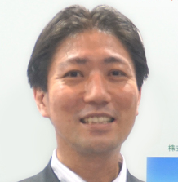
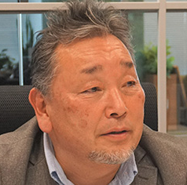
04 – Clients Network
Customer Testimonials
“We can work with Rikkeisoft’s teams completely in Japanese, so it’s very comfortable and easy to work with them.”
“Rikkeisoft’s leaders have excellent Japanese conversational skills. They do not need interpreters, instead directly conveying project information, specifications, and intentions. Subtle nuances are not lost during our conversations.”
“I am really proud of everything our team and Rikkeisoft have achieved so far, in less than 2 years of partnership. Many people have put in a lot of long hours, late nights and early mornings, and hard work to create the capability we have today.”
“The current RKTeach team irepresents a high level of professionalism and teamwork. The team functions so well that they have inspired our other teams to work with renewed purpose.”
Daisuke Kawasaki
Saito Makoto
H. G.
VP, Digital Transformation Dept.;
Program Manager,
Online Delivery Bureau of USMH
Executive Officer, CTO of QES group
Global Head of Operations Technology (SVP)
Global Asset Management Firm based in U.S​

Slide 30







RIKKEISOFT CORPORATION
Headquarter:
21st Floor, Handico Tower, Pham Hung, Me Tri, Nam Tu Liem, Hanoi, Vietnam
Offices:
Da Nang: 11th Floor, VietNam News Agency Building, 81 Quang Trung St., Hai Chau Dist, Danang, VietNam
Ho Chi Minh City: 7th Floor, Maritime Safety South Building, 42 Tu Cuong St., Ward 4, Tan Binh Dist, Ho Chi Minh City, Vietnam
Hue City: 62 To Huu St, Xuan Phu Dist, Hue City, Vietnam
RIKKEI JAPAN
Headquarter:
3rd Floor, Fujishima Building, Tamachi 16 Street, 4-13-4 Shiba, Minato-ku, Tokyo, Japan
Thank you
Offices:
Osaka: 2nd Floor, Office’ Port Osaka, 3-5-10 Nishitenma, Kita-ku, Osaka, Japan
Nagoya: 40th Floor, Nagoya Lucent Tower, 6-1 Ushijima-cho, Nishi-ku, Nagoya, Japan
Fukuoka: Hakata Suncity Building 507, Hakataekiminami 2-chōme−1−5, Hakata-ku, Fukuoka, Japan
RKTECH CORP.
Headquarter:
Preston Park Towers West, 4975 Preston Park Blvd, Suite 505, Plano, Texas, 75093
RIKKEI THAILAND
Headquarter:
Ramaland building, no. 952 Rama IV Road, Khwaeng Suriyawongse, Khet Bangrak, Bangkok, Thailand
contact@rikkeisoft.com
www.rikkeisoft.com
RKSOFT CORP.
Headquarter:
Sparkplus Gangnam, 327 Gangnam-daero, Seocho District, Seoul, South Korea

